Slide 1

TEAM CLOUD OPTIMIZERS An OpenSimplex approach : Hadoop performance optimization by auto tuning default configuration parameter
VINAY KHEDEKAR TEJAS GHALSASI MOMTAZ AFREDI

Slide 2
Agenda
1. Background- Hadoop MapReduce System
2. Hadoop core configurations
3. Role of configurations in Hadoop MapReduce
4. Why we need Auto tuning over an Manual tuning
5. What are the existing configuration tuning approaches ?
What are there limitations ?
6. Our solution for auto tuning the configuration parameters :
An OpenSimplex approach

Slide 3


HADOOP | MAPREDUCE

Slide 4
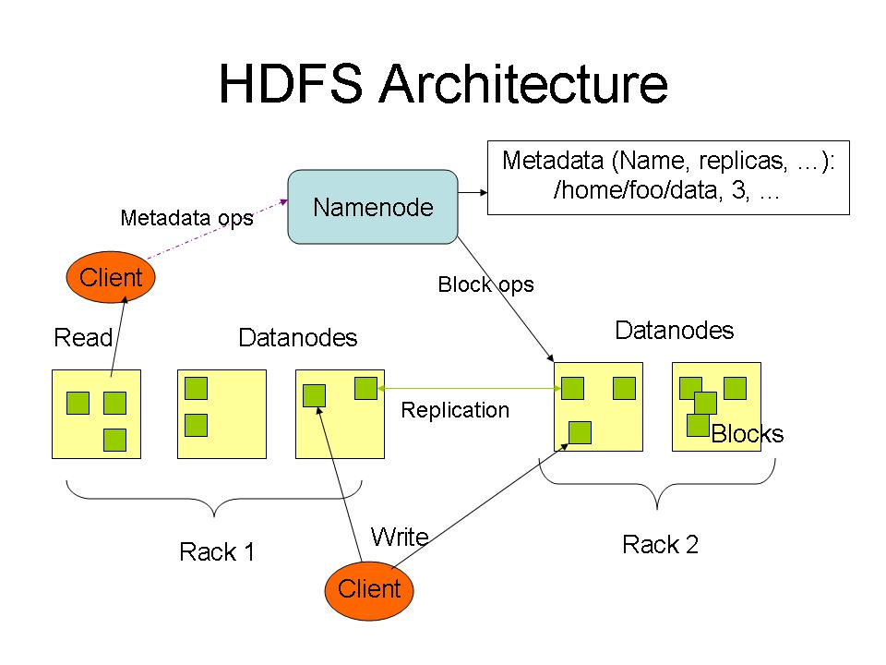

Slide 5
MapReduce: The Map Step
Input
key-value pairs
Intermediate
key-value pairs
k
v
map
k1
v1
k
v
k2
v2
map
k
v
…
…
kn
vn
k
v
E.g. (doc—id, doc-content)
E.g. (word, wordcount-in-a-doc)

Slide 6
MapReduce: The Reduce Step
Intermediate
key-value pairs
Output
key-value pairs
Key-value groups
k
v
k
v
v
v
reduce
k
v
reduce
k
v
k
v
group
k
v
v
k
v
…
…
…
k
v
k
v
k
v
E.g. (word, wordcount-in-a-doc)
(word, list-of-wordcount)
(word, final-count)
~ SQL Group by
~ SQL aggregation

Slide 7
Basic Features of Hadoop
Highly fault-tolerant
High throughput
Suitable for applications with large data sets
Streaming access to file system data
Can be built out of commodity hardware

Slide 8


Slide 9
Hadoop Configurations
The Hadoop framework has more than 190 tunable configuration parameters that allow users to manage the flow of a Hadoop job in different phases during the execution process.
Some important configurations are discussed in the next slide.

Slide 10
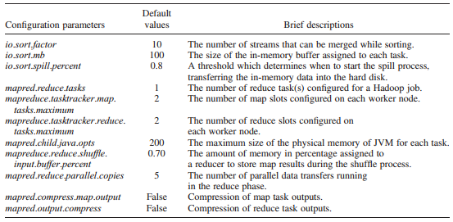
Hadoop Core Configurations

Slide 11
How Configuration Parameters Plays Critical Role in Hadoop
JVM Configuration
different JVM command-line switches and their potential impact on performance of Hadoop workloads.
OS Configuration
information about impact of tuning Linux OS properties on Hadoop performance.
BIOS configuration
Some of the BIOS parameters that could potentially impact Hadoop performance.

Slide 12
Why we need Auto Tuning over Manual Tuning
Time consuming process –
A small change in the configuration parameter settings can have a significant impact on the performance of a Hadoop job.
Manually tuning the optimum or near optimum values of these parameters is a challenging task and also a time consuming process
Black box like feature –
It extremely difficult to find a mathematical model or an objective function, which represents a correlation among the parameters.
Large parameter space
The complex correlations among the configuration parameters further increases the complexity of a manual tuning process.
Therefore, an effective and automatic approach to tuning Hadoop parameters has become a necessity.

Slide 13
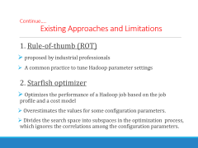
Existing Approaches and Limitations
A number of research works have been proposed to automatically tune Hadoop parameter settings.
1. Rule-of-thumb (ROT)
2. Starfish optimizer
3. PPABS (Profiling and performance analysis based system)
4. Gunther

Slide 14
Continue…. Existing Approaches and Limitations
1. Rule-of-thumb (ROT)
proposed by industrial professionals
A common practice to tune Hadoop parameter settings
2. Starfish optimizer
Optimizes the performance of a Hadoop job based on the job profile and a cost model
Overestimates the values for some configuration parameters.
Divides the search space into subspaces in the optimization process, which ignores the correlations among the configuration parameters.

Slide 15
Continue…. Existing Approaches and Limitations
3. PPABS (Profiling and performance analysis based system)
Automatically tunes Hadoop parameter settings based on the executed job profiles.
Employs K-means++ to classify the jobs into equivalent classes
Applies simulated annealing to search for optimum parameter values
PPABS is unable to tune the parameter settings for a new job, which does not belong to any of the pre-classified classes

Slide 16
Continue…. Existing Approaches and Limitations
4. Gunther
Genetic Algorithm- A search based system proposed, automatically searches for optimum parameter values for the configuration parameters using genetic algorithm.
Critical limitation of Gunther is that it does not have a fitness function in the implemented genetic algorithm.
Gunther evaluates the fitness of a set of parameter values by running a Hadoop job physically, which is a time consuming process.

Slide 17
What is an OpenSimplex Approach…?
The OpenSimplex approach is, auto-tuning the default Hadoop configuration parameters by finding the correlation and cross communication dependencies among configuration parameters and optimizing accordingly.
OpenSimplex is a two step process-
Step 1 : Find the correlation among Hadoop configuration parameters
Step 2 : Optimize the configuration parameters

Slide 18
Practical Approach
Gene Expression Programming (GEP)
Build an objective function to find out correlation among configuration parameters
OpenSimplex Parameter Optimization
Uses OSP constructed object
Considers whole search space to maintain inter dependencies
Searches set of optimal/ Near optimal values
New Optimized parameter values

Slide 19
Experimental Setup
Two Hadoop Clusters and Two Applications
1. Cluster A
Virtual Machines - 4
Application - Word Count ( CPU Intensive)
Operating System - Ubuntu 11.04 Server x64, Oracle JDK6 update 25 x64
2. Cluster B
Virtual Machines - 4
Application - Sort ( I/O Intensive)
Operating System - Ubuntu 11.04 Server x64, Oracle JDK6 update 25 x64

Slide 20
Agenda
Technical Setup
Hadoop
Map Reduce
Configurations
Technical Design & Implementation
Demo

Slide 21
Technical Setup
Hadoop Setup follows a series of steps which will be demonstrated in the following slides.

Slide 22
Technical Setup
Configurations
Hadoop Configurations
→ Config.sh file contains the system configurations which includes Hadoop configurations and required system configurations.
Cluster Configurations
MapReduce Job Configurations
→ Config.xml file contains all the MapReduce parameter list.

Slide 23
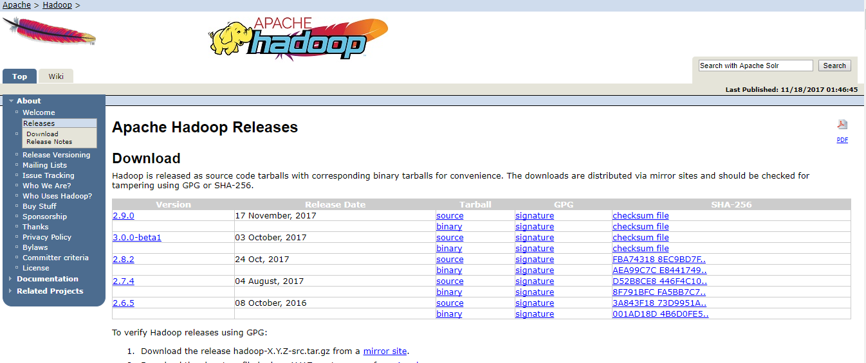
Hadoop Setup
Download Hadoop 2.8.x(Stable) from Apache Hadoop Website

Slide 24
Hadoop Setup
Unzip the Files using file extraction software into /usr/local/Hadoop-2.8.x/
Install Java and SSH
Set up the following main files:
~/.bashrc
/usr/local/hadoop/etc/hadoop/hadoop-env.sh
/usr/local/hadoop/etc/hadoop/core-site.xml
/usr/local/hadoop/etc/hadoop/mapred-site.xml.template
/usr/local/hadoop/etc/hadoop/hdfs-site.xml

Slide 25
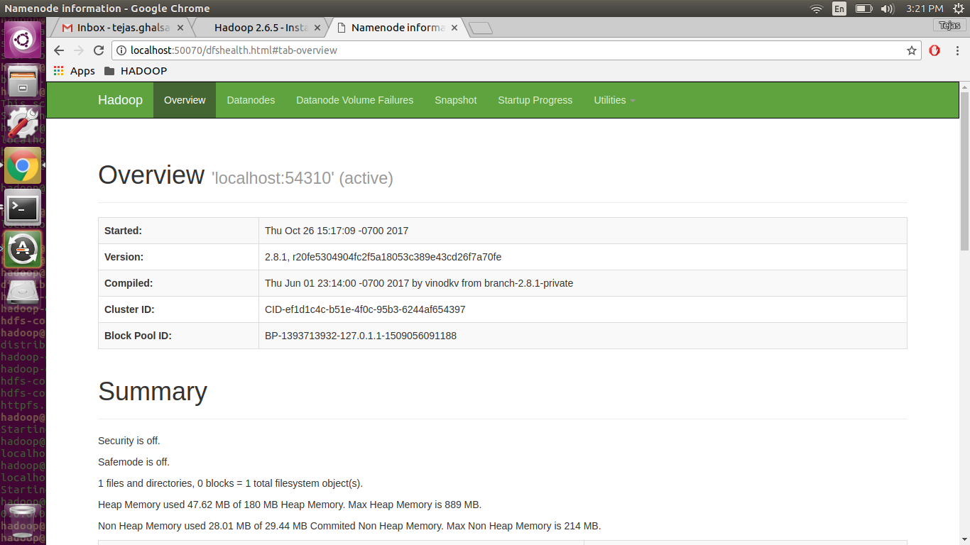
Once Everything is correctly Setup you should see this when you access the localhost

Slide 26
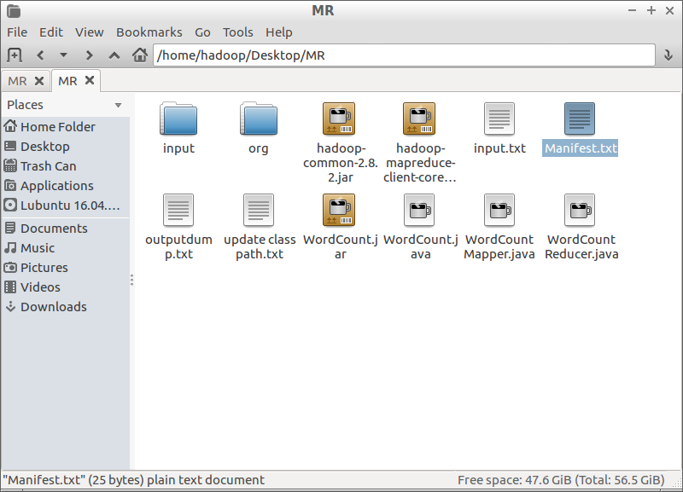
MAP Reduce Folder should look like:
Move the Shakespeare Literature text file inside the HDFS

Slide 27
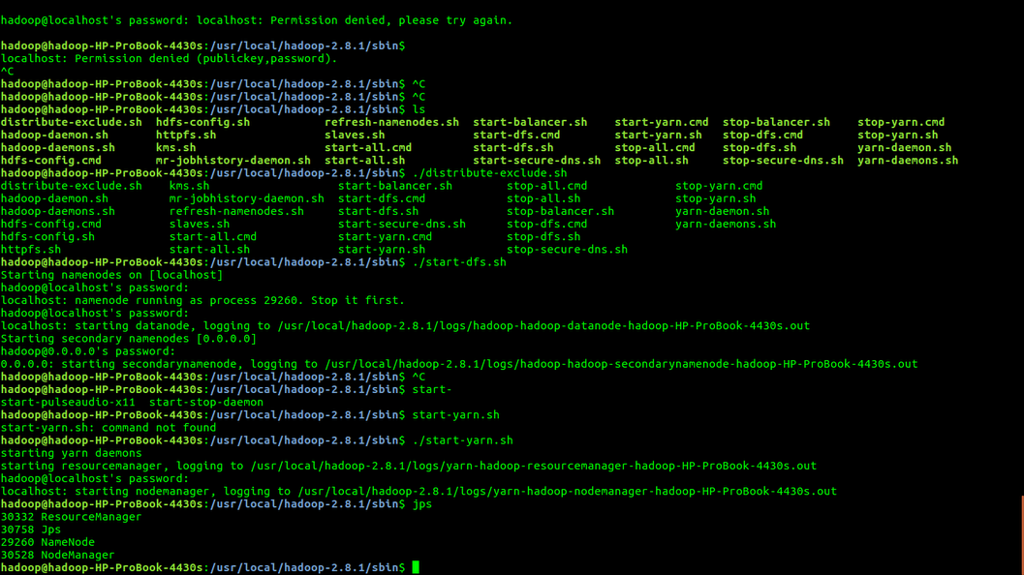
Map Reduce
The Map Reduce classes need to be packed in a jar fire
The jar file is to be added to the class path

Slide 28
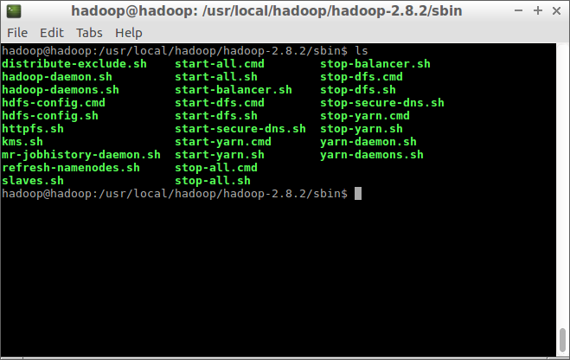
Go to Sbin and Execute

Slide 29
Technical Design and Implementation
Profiler
Analyzes the MapReduce job, configuration parameters and build a job profile which recommend which parameters to be optimized
Optimizer
Perform cost based optimization
Finds best configuration parameter space point.
Auto tune the configuration parameters using best point.
Recommended Optimized Configuration Settings

Slide 30
Technical Implementation 1. Profiler
Gathers the job history files, the task profiles
It Generates the job profile
Build and return the job identifier (e.g., job_23412331234_1234)
Static methods for enabling and performing MapReduce job profiling.
There are couple of methods are inside this class that will enable static and dynamic profiling using the BTraceTaskProfile and BTraceTaskMemProfile scripts for all the job tasks.
The output is sent to the Optimizer for further .

Slide 31
Technical Implementation
2. Optimizer
How Optimizer works technically…???
Inputs -
Job Profile
Cluster Configuration
Hadoop Configuration
Scheduler
Job Submission Time
Data Model

Slide 32
Technical Implementation
2. Optimizer
Optimize( Job Submission Time)
find best parameter space point ( collection parameter space, current configured parameter values)
for ( Each point in the parameter space )
{
populate configuration value;
Calculate current execution time for job with each configuration parameter value

Slide 33
Technical Implementation
2. Optimizer
if ( Current Time < MAX_VALUE )
{
minimum Time = current time;
Best point = current configuration parameter;
}
}
3. Copy ‘Best Configuration’ to ‘current configuration’
The parameter configuration will be set as best point, If the execution time with parameter value is less than maximum execution time.

Slide 34
Demo
&
Execution of OpenSimplex- Hadoop Auto-tuning

Slide 35
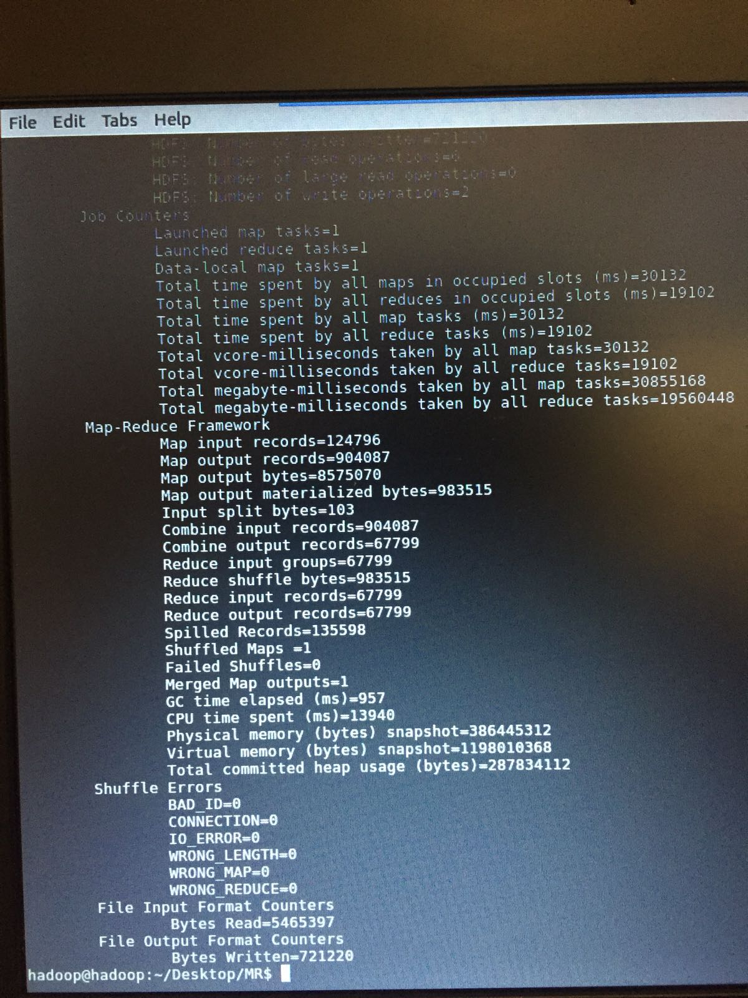
Execution

Slide 36
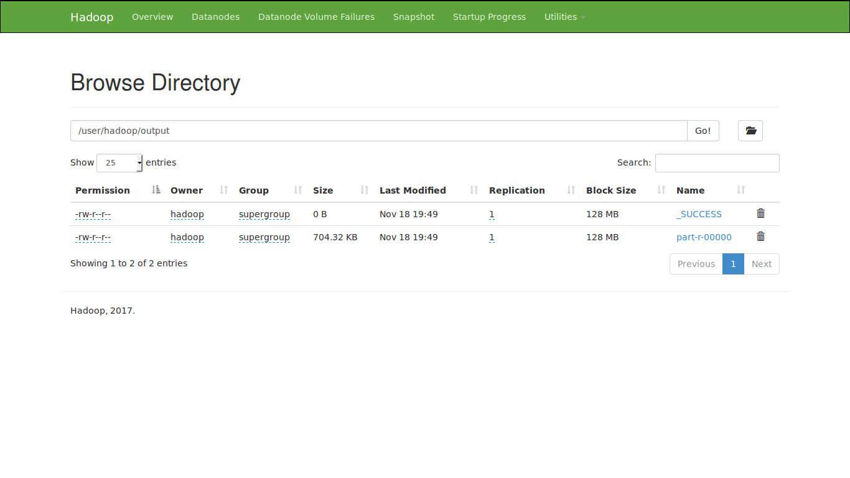
Output on the Web monitor

Slide 37
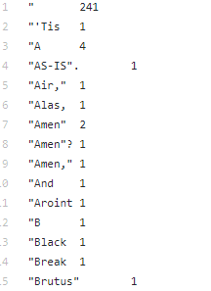
Mined Text File Screenshot
https://goo.gl/iAJSck

Slide 38
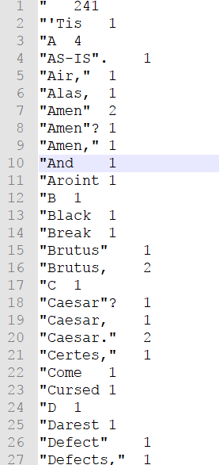
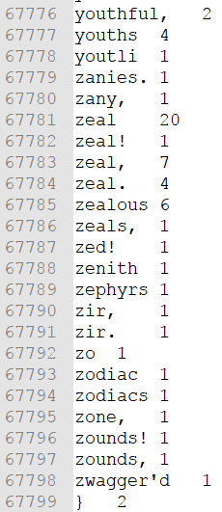
Mined Text File Screenshot

Slide 39

THANK YOU ALL!

